Slide 1
Yelp Restaurant Suggestion Queue
Arif-Chuang-Hori-Teehan

Slide 2
Goals
• Create a platform that can provide recommendations for restaurants based on input restaurants
• We plan to do some further analysis on a city by city basis or a neighborhood basis to analyze some questions of interest
Notes:
• How long does it take for restaurants to become popular in different neighborhoods/cities?
• Do different cities and neighborhoods have preferences for certain types of restaurants based on cuisine or other factors of interest?

Slide 3
Timeline
Fifth Week - Study the HTML of the Yelp website to determine how we will go about crawling for data. Learn how to use the Yelp API.
Sixth Week- We will begin writing code to scrape the website, construct our restaurant class, and also determine what sort of algorithm we hope to use to make recommendations.
Seventh Week- Finding out which users have reviewed different restaurants, and determine if there are patterns between restaurants.
Eighth Week- Begin building the actual platform for users.
Ninth Week- Part of the platform will include general information by neighborhood/city on what trends seem to emerge for that location. Continue analyzing the data for interesting trends.
Notes:
Fifth Week- We’ll study the HTML of the Yelp website to determine how we will go about crawling for data. Learn how to use the Yelp API.
Sixth Week- We will begin writing code to scrape the website, construct our restaurant class, and also determine what sort of algorithm we hope to use to make recommendations. Once we have an idea of what data we will have, we can determine how we want to connect different restaurants.
Seventh Week- Finding out which users have reviewed different restaurants, and determine if there are patterns between restaurants. Following this, we may be able to expand our data set to include cities outside of Chicago, and add more restaurants. Join all datasets from Yelp Dataset Challenge based on the user

Slide 4
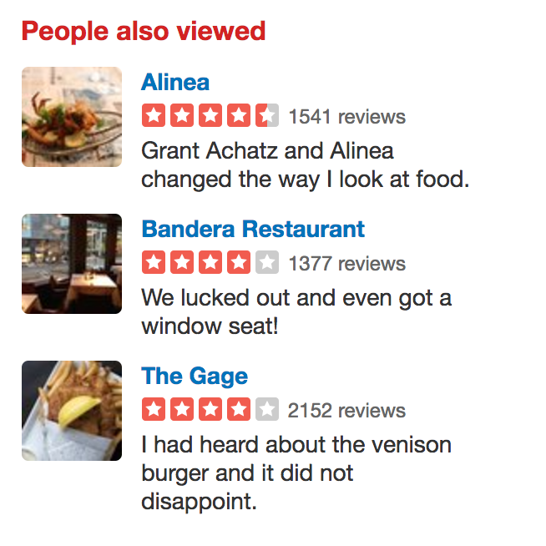
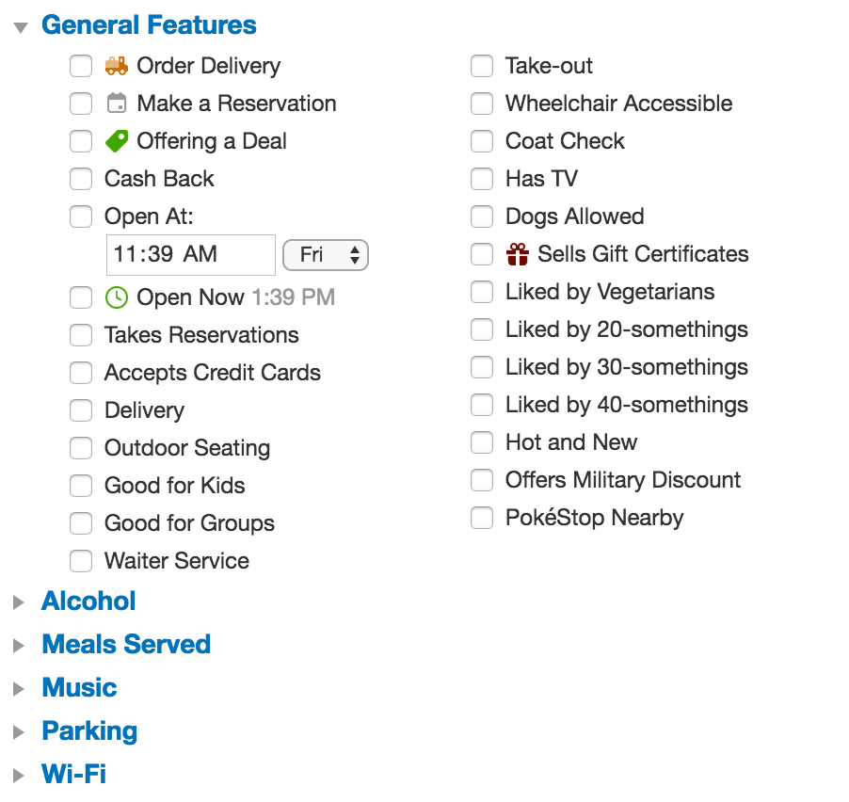
Generating Recommendations
Two people who like the same restaurant will also like other similar restaurants
Takes unique IDs of the users who have reviewed the input restaurant and checks what other restaurants they have reviewed
Finds common characteristics of restaurants and returns these characteristics
Create review word count and compare across reviews
Notes:
Recommendation system:
Link datasets to determine the network of recommendations from one unique user ⇒ similar likes will yield similar likes
If you leave a positive review for Au Cheval, and I like Au Cheval, then I will probably like other restaurants you have reviewed favorably
Each restaurant has a characteristics and properties ⇒ compare characteristics across restaurants to see what users value ⇒ maybe values are the same across users
Crawl and keep track of word usage and count during reviews to determine if words and vocabulary can yield insights to recommendations

Slide 5
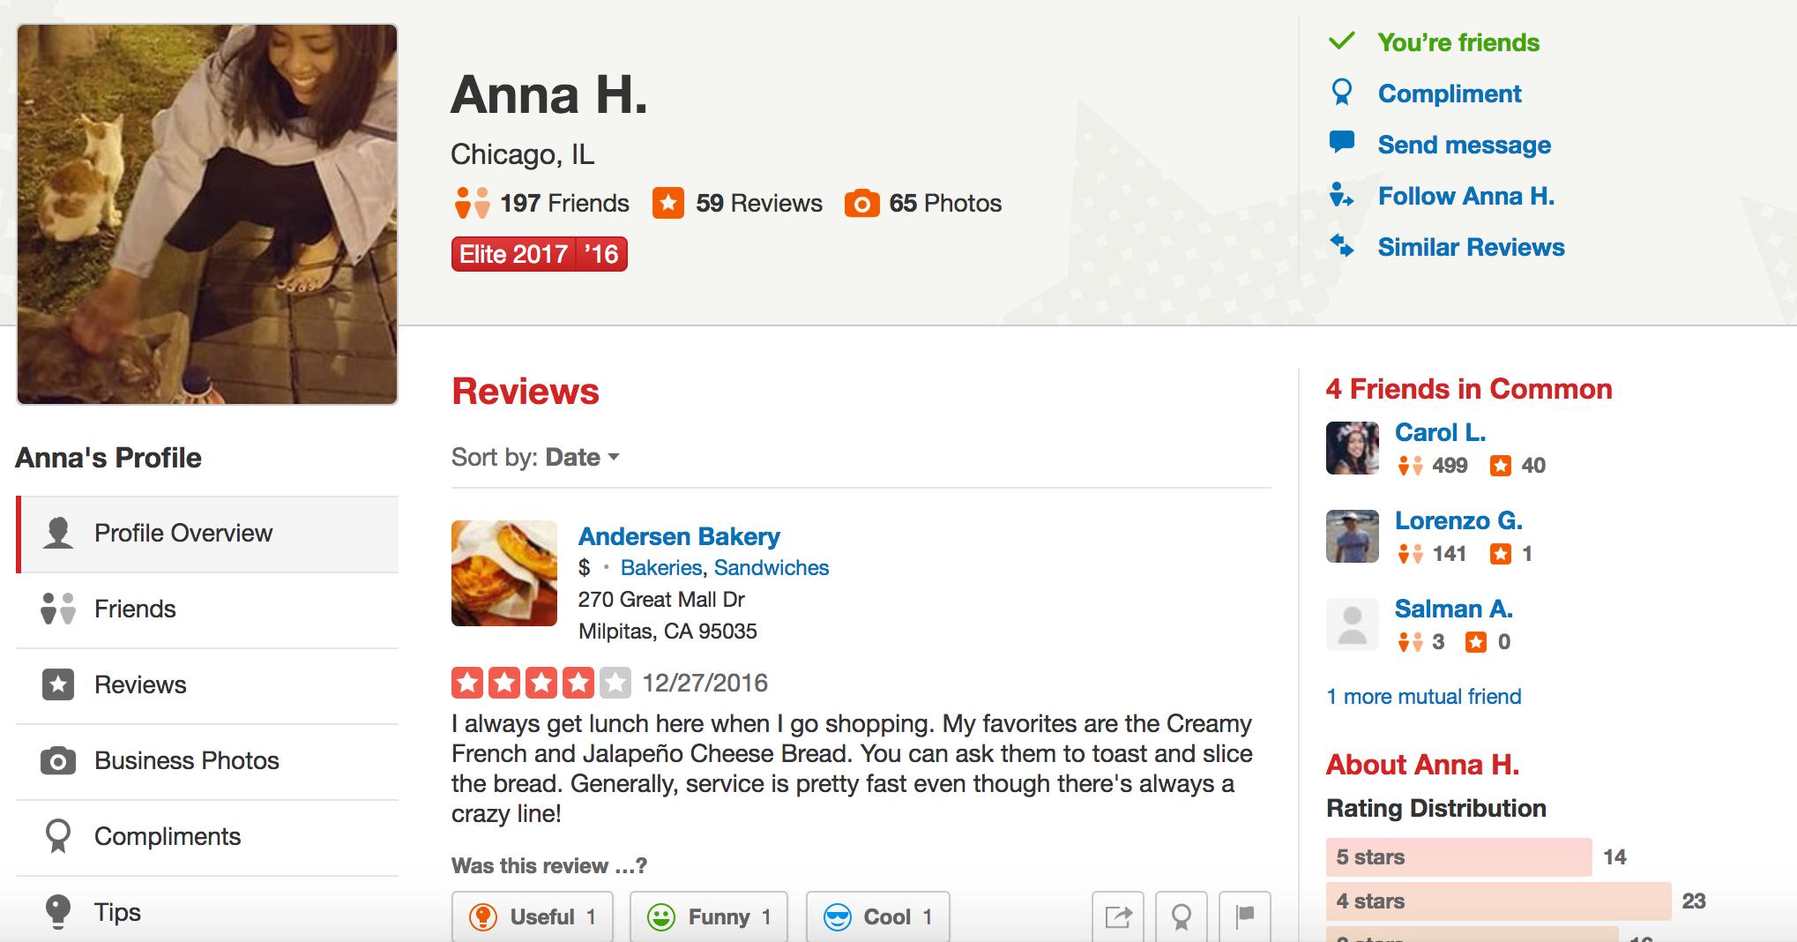
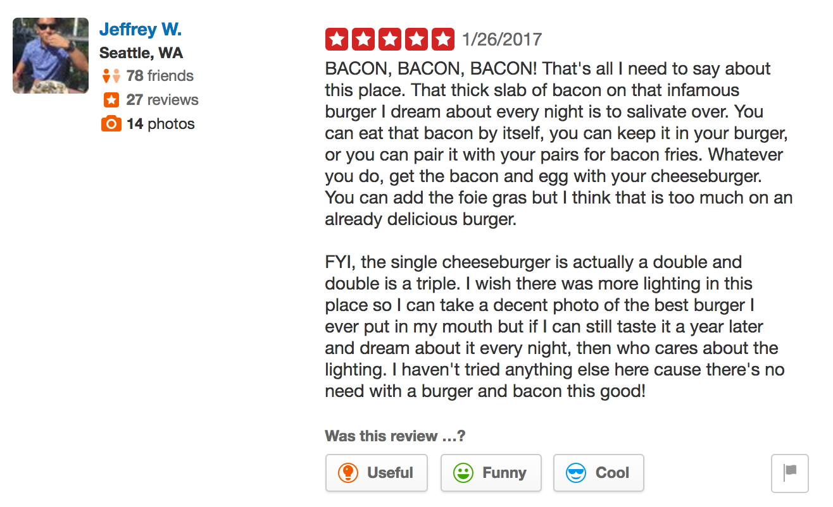
Description of the Data
Yelp has data available from Dataset Challenge
JSON format
Yelp_academic_dataset_review.json
yelp_academic_dataset_business.json
Notes:
{ "user_id":"encrypted user id", "name":"first name", "review_count":number of reviews, "yelping_since": date formatted like "2009-12-19", "friends":["an array of encrypted ids of friends"], "useful":"number of useful votes sent by the user", "funny":"number of funny votes sent by the user", "cool":"number of cool votes sent by the user", "fans":"number of fans the user has", "elite":["an array of years the user was elite"], "average_stars":floating point average like 4.31, "compliment_hot":number of hot compliments received by the user, "compliment_more":number of more compliments received by the user, "compliment_profile": number of profile compliments received by the user, "compliment_cute": number of cute compliments received by the user, "compliment_list": number of list compliments received by the user, "compliment_note": number of note compliments received by the user, "compliment_plain": number of plain compliments received by the user, "compliment_cool": number of cool compliments received by the user, "compliment_funny": number of funny compliments received by the user, "compliment_writer": number of writer compliments received by the user, "compliment_photos": number of photo compliments received by the user, "type":"user" }

Slide 6
Platform
The user can input a list of restaurants that they like, along with restrictions such as a price level and location.
Then, the pages for those restaurants will be scraped for particular attributes (family friendliness, noise level, etc.) as well as particular keywords (such as “customer service”).
Then, it returns a list of restaurants in the target city that match to a greater or lesser degree, along with a list of what matches associated with each.

